Slide 1
The basic transformations
The basic
transformations

Slide 2
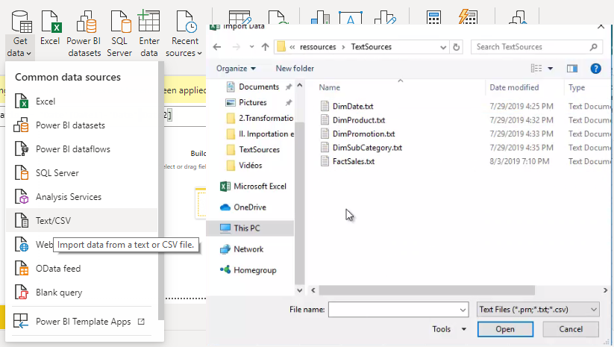
Basic Transformations
Note: This lab uses the file TextSources \FactSales.txt located in the resources folder
FactSales.txt

Slide 3
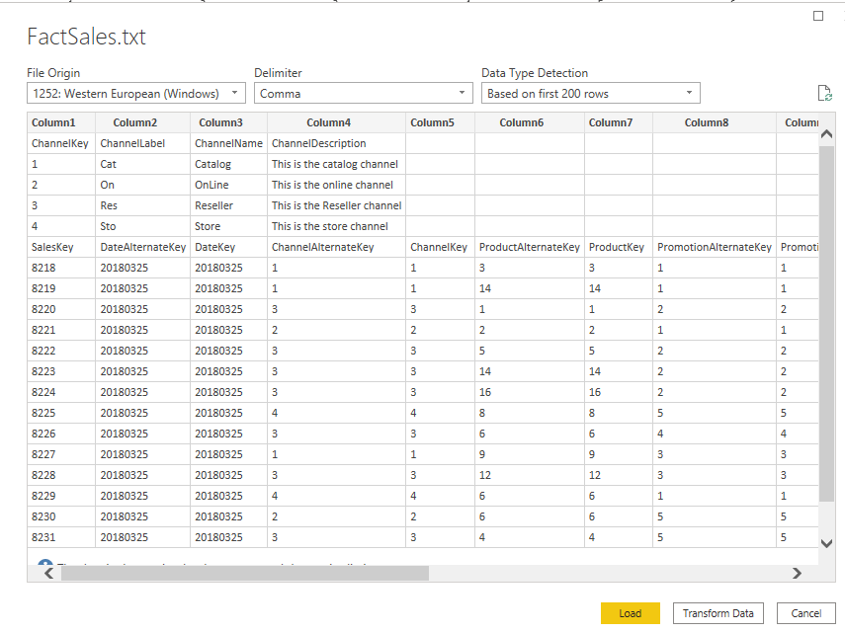
Basic Transformations
Load the file into the editor and notice that the table structure is inconsistent

Slide 4
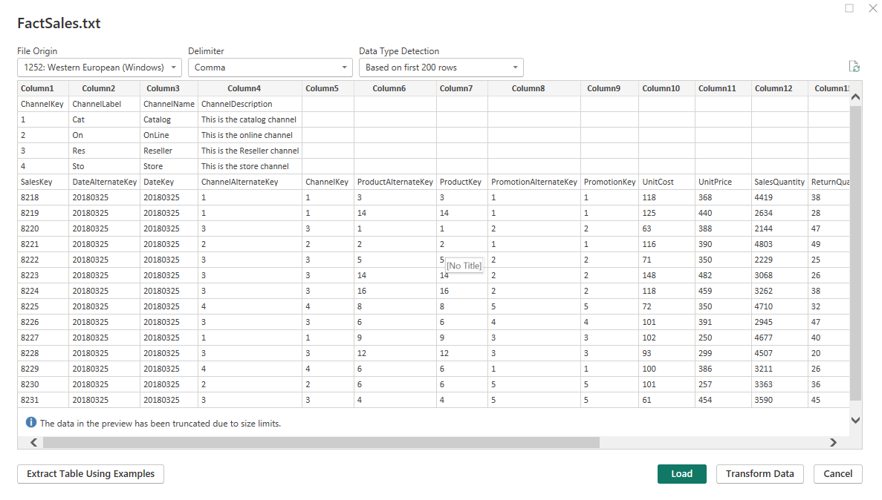
Basic Transformations
Open the query in the query editor

Slide 5
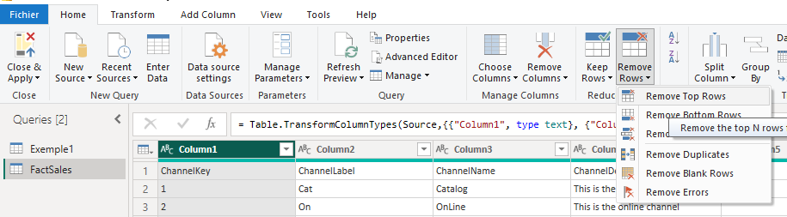
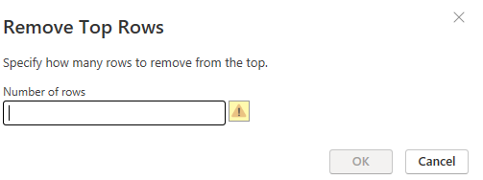
Basic Transformations
Try deleting the first four lines, by selecting Home , then Delete Lines > Delete First Lines

Slide 6
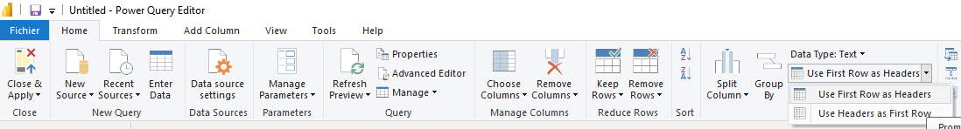
Basic Transformations
Set the first row as a set of column headers

Slide 7
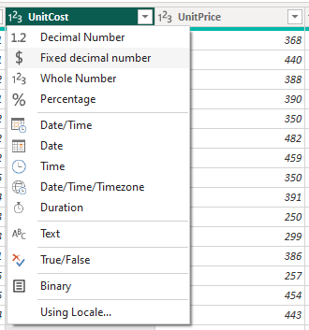
Basic Transformations
Configure the appropriate column types, e.g. UnitCost , UnitPrice , Return , Amount … should be of currency type instead of number

Slide 8
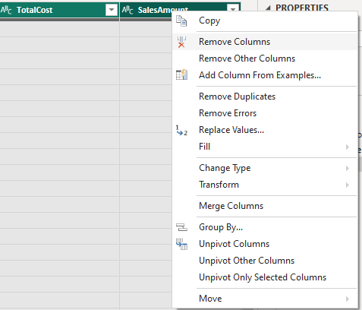
Basic Transformations
Delete empty columns​

Slide 9
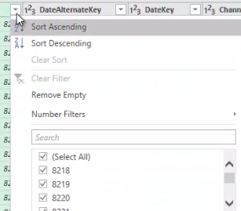
Basic Transformations
Try sorting the data and explore the context menu mentioned below

Slide 10
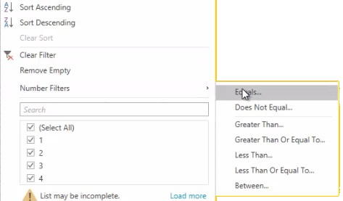
Basic Transformations
Try testing the Digital Filters menu
Manufacturer and BrandName columns there are null values

Slide 11
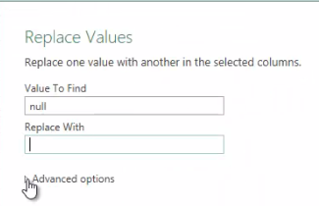
Basic Transformations
Try replacing the null values with No manufacturer and No Brand name for the Manufacturer and BrandName columns respectively, using the Replace Values feature

Slide 12
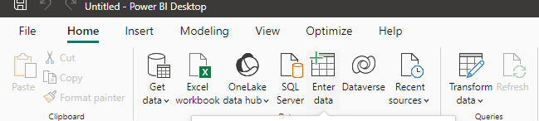
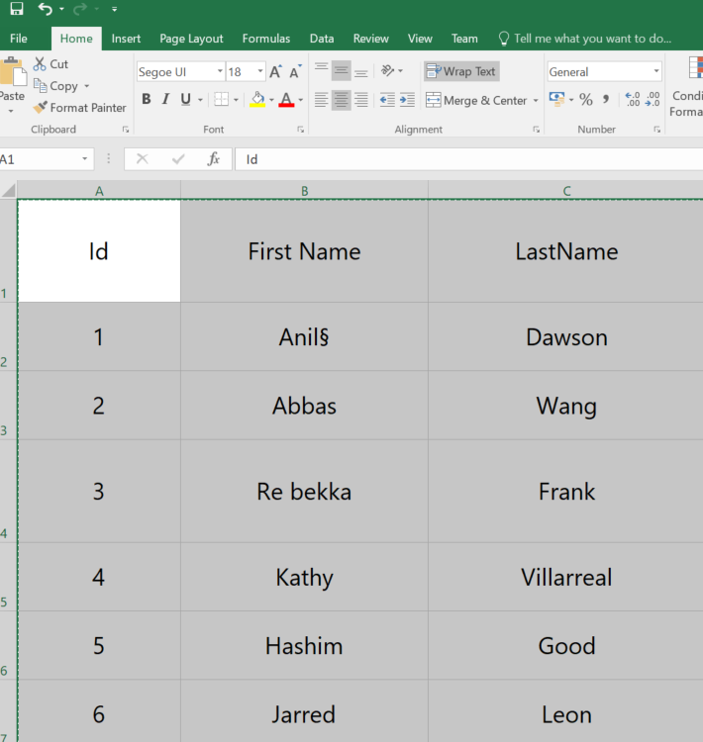
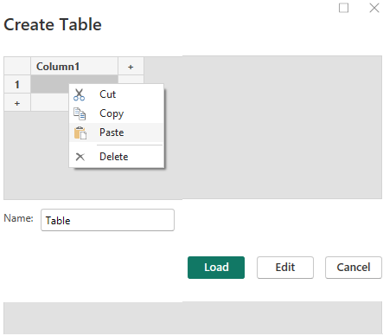
Basic Transformations
Import data into a Names table from Excel to Power BI
Id | First Name | LastName
1 | Anil§ | Dawson
2 | Abbas | Wang
3 | Re bekka | Frank
4 | Kathy | Villarreal
5 | Hashim | Good
6 | Jarred | Leon

Slide 13
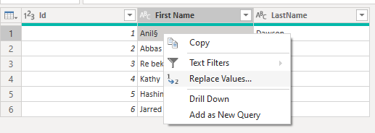
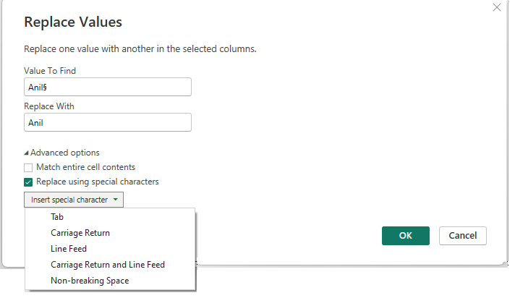
Basic Transformations
Notice that the first line shows a so-called non-printing character § , and on the third line there is also an incorrect space in the name. Try removing the unwanted character.
Look in Advanced Options
Try the Replace using option
a special character

Slide 14
Basic Transformations
Notice that the first line shows a so-called non-printing character § , and on the third line there is also an incorrect space in the name. Try removing the unwanted character.
Look in Advanced Options
Try the Replace using option
a special character

Slide 15
Thank you
Thank you

